Slide 1
AWS Auto Scaling and
Load Balancing
Optimizing Scalability and Availability in the Cloud

Slide 2
Agenda
Auto Scaling
Load Balancing
Key Features and Benefits
How They Work Together
Use Cases
Real-World Examples
Demo (Optional)
Summary

Slide 3
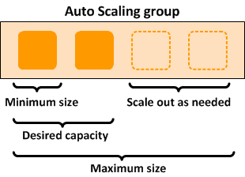
Auto Scaling
Automatically adjusts the number of compute resources to meet demand.
Key Benefits:
Ensures application availability.
Reduces costs by scaling down during low traffic.
Improves performance during traffic spikes.

Slide 4
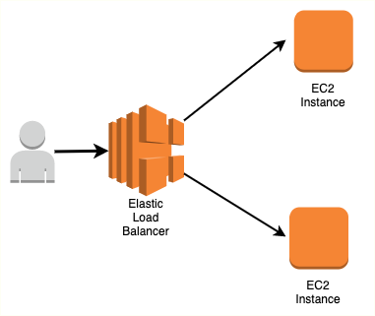
Load Balancing
Distributes incoming traffic across multiple resources to prevent overloading any single resource.
Types of Load Balancers in AWS:
Application Load Balancer (ALB): Layer 7 (HTTP/HTTPS) routing.
Network Load Balancer (NLB): Layer 4 (TCP/UDP) routing.
Classic Load Balancer: Legacy support for Layer 4 and 7.

Slide 5
Key Features and Benefits
Auto Scaling Features:
Dynamic Scaling: Automatically adjusts resources based on traffic.
Predictive Scaling: Uses machine learning to predict demand patterns.
Scheduled Scaling: Pre-defined scaling based on known traffic times.
Load Balancing Features:
Health Checks: Ensures traffic is sent only to healthy instances.
Sticky Sessions: Keeps user sessions connected to the same instance.
SSL Termination: Manages SSL decryption to offload instance workload.
Cross-Zone Load Balancing: Distributes traffic evenly across zones.

Slide 6
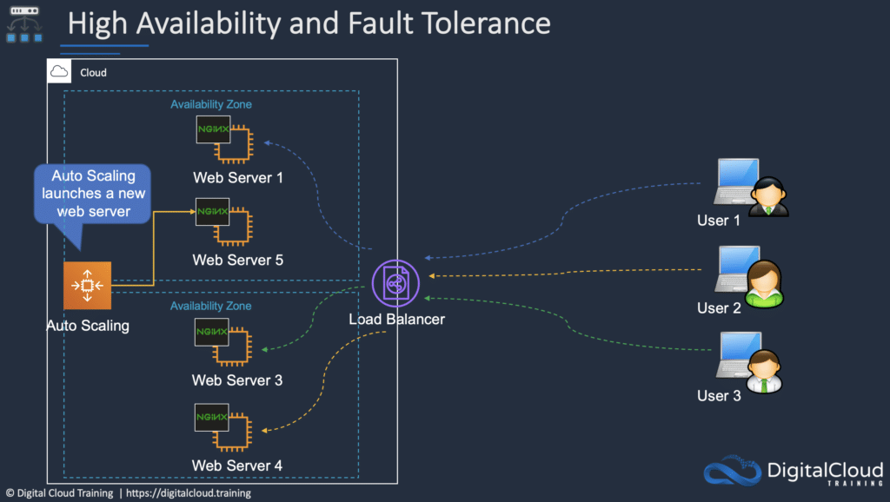
How They Work Together
Scenario: High traffic to a web application.
Load Balancer distributes traffic to multiple instances.
Auto Scaling adds more instances as traffic increases.
When traffic decreases, Auto Scaling reduces instances to save costs.
Outcome: Improved performance, reduced costs, and no downtime.

Slide 7
Use Case
E-commerce Platforms: Handle seasonal traffic spikes during sales events.
Media Streaming: Maintain smooth streaming by scaling resources based on viewer demand.
Web Applications: Ensure high availability and seamless user experiences.

Slide 8
Real-World Example
Case Study:
A streaming service like Netflix uses Auto Scaling to dynamically allocate resources during new show launches.
Load Balancers ensure traffic is evenly distributed among servers to prevent crashes.
Metrics:
99.99% uptime.
Significant cost savings during off-peak hours.

Slide 9
Demo Step
Step 1: Create an Auto Scaling group in the AWS Management Console.
Step 2: Attach an Application Load Balancer.
Step 3: Configure scaling policies and health checks.
Step 4: Monitor scaling activities in CloudWatch.

Slide 10
Summary
Auto Scaling ensures cost-efficient scalability by adjusting resources dynamically.
Load Balancing enhances application availability and distributes traffic efficiently.
Together, they form the backbone of resilient cloud architectures.

